Slide 1
Midterm 1
Compiler design by dr. saeed parsa
Iran university of science and technology

Slide 2
Important Notes
Any similarity to other’s answers will lead you to get lower score, so please answer all question by yourself.
You have 75 minutes time plus 5 minutes for uploading your documents.
Question number = (sum of your student ID digits) mod 3 + 1
For example if your student number is 123 then your question’s section number is (1+2+3) mod 3 + 1 = 1

Slide 3
Your Personal Info
Enter your full name: AmirHossein Ahmadi
Enter your student ID: 97522292
Enter your question section number: 3

Slide 4
Question 1 (Explain)
Score: 25%
What are the steps of a compiler? Explain each step in 1 or 2 lines.
What is ANTLR? Explain how it works.
What is lexical analysis and how it works.
Upload a PDF using cam scanner or similar apps.

Slide 5
Question 2 (Lexical Analysis)
Score: 25%
Write a lexical function to accept all binary strings ending with 101.
Write a lexical function to accept all binary strings which starting with 001.
Write a lexical function to accept all binary strings including 110.
Upload a PDF using cam scanner or similar apps.

Slide 6
Question 3 (ANTLR and Python)
Score: 50%
Write a program using ANTLR and Python to add your student ID to all comments in a Java file.
Write a program using ANTLR and Python to convert multi-line comments (/* */) to single line comments ( // ) in a Java file.
Write a program using ANTLR and Python to delete all comments and blank lines from a Java file.
Upload your codes and screenshots.

Slide 7
q1
The lexical analyzer is usually a function that is called by the parser when it needs the next token. The main task of the lexical analyzer is to read the input characters of the source program, group them into lexemes, and produce as output a token for each lexeme in the source program.
Example: if(x>3)
Keyword: if
Bracket : (
Identifier : x
Operator : >
Number : 3

Slide 8
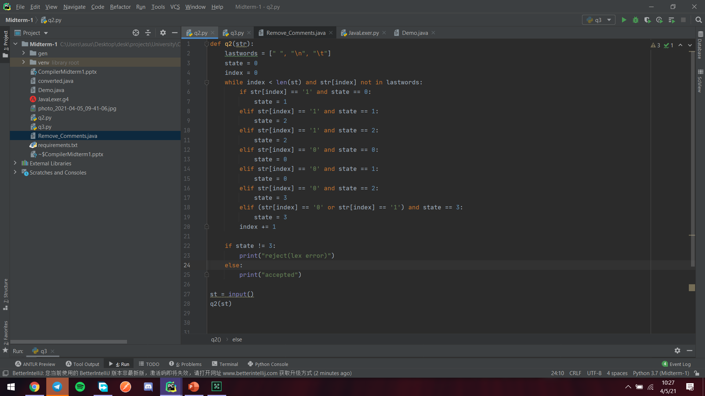

Slide 9
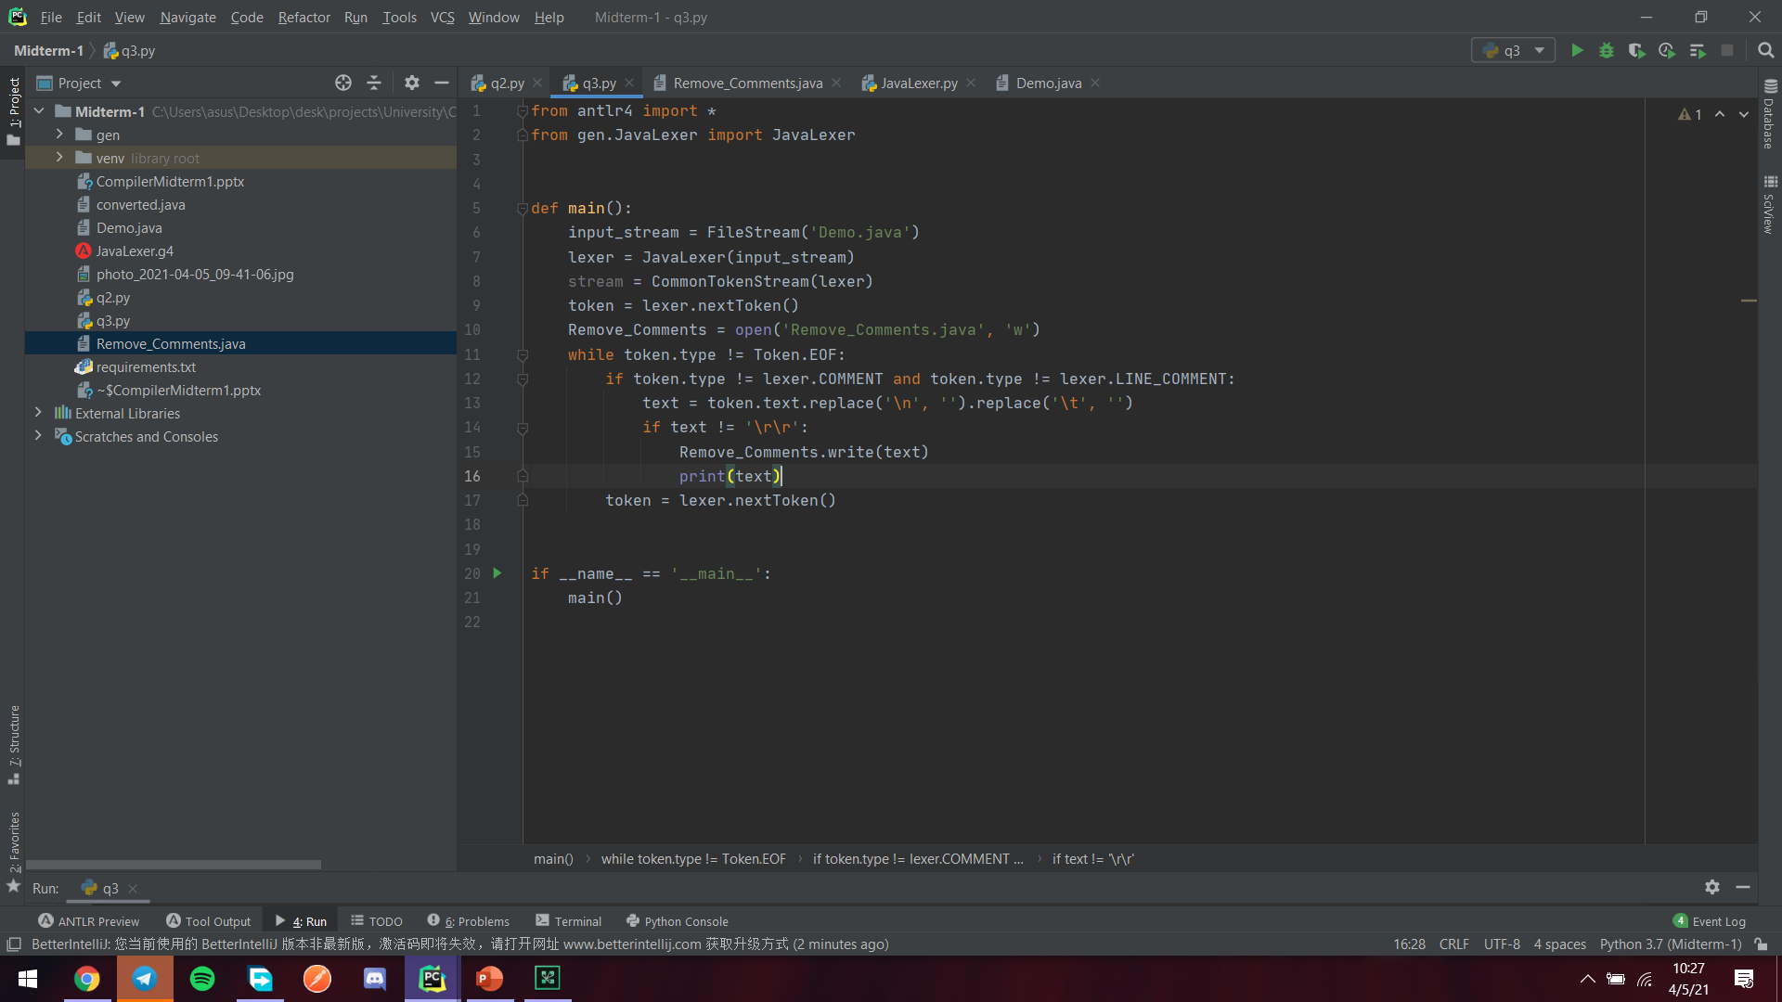

Slide 10
